Slide 1
Indigenous Action Circle Report 2020
Report on activities of the Chair
Report on activities of the Circle

Slide 2
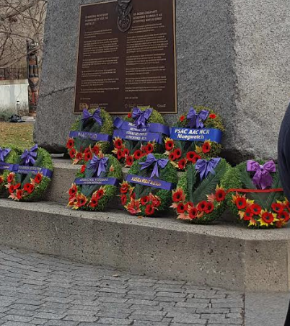
As Chair of IAC - events
Paying respects to Indigenous veterans laying wreath at the Remembrance Day ceremonies
CEIU Human Rights and Race Relations conference
Ontario federation of Labour Convention as a member of the OFL Aboriginal Circle
Health and Safety conference in Montreal
Attending National Human Rights Committee of PSAC
Facilitating Indigenous Solidarity Course for PSAC NCR
Speaking at Human Rights Event PSAC NCR

Slide 3
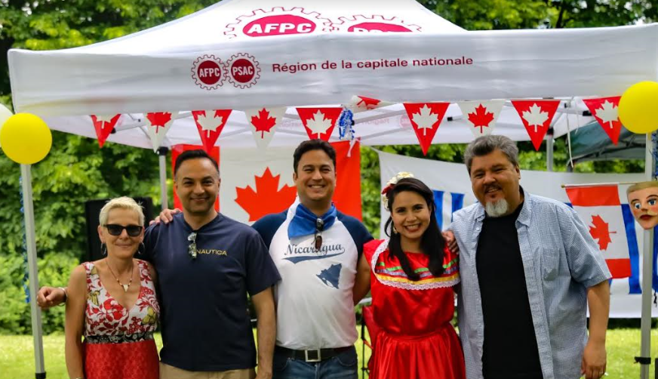
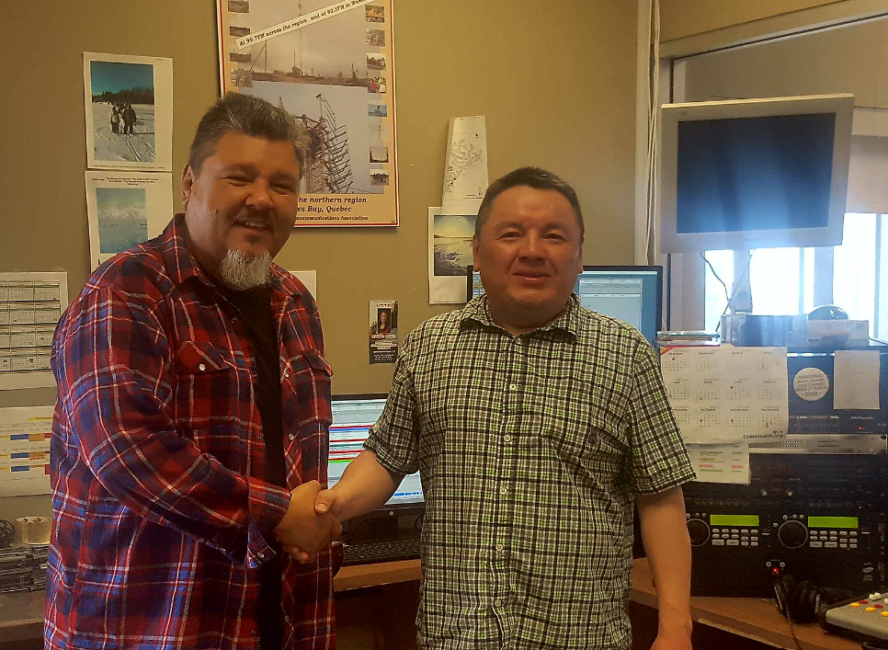
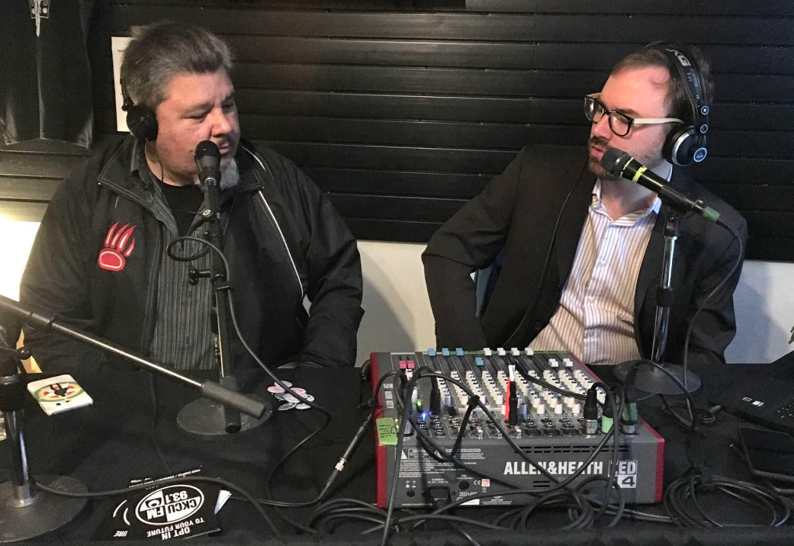
IAC Working in Community & partners
Hosting Indigenous Community radio show
Touring Indigenous Radio Station in Wemindji Quebec
Hosting Chair of Pride on CKCU radio show to highlight LGBT artists and events for pride week
Attending Cultural BBQ events for SOS Nicaragua to protest repression and violence
IAC Working with Spaceman to raffle guitar for Indigenous youth
Indian Horse Film Night at Gilmour with RVAC
Nicaraguan community BBQ with PSAC members.
Wemindji radio station with Emmett Georgekish
Live radio broadcast from Spaceman music

Slide 4
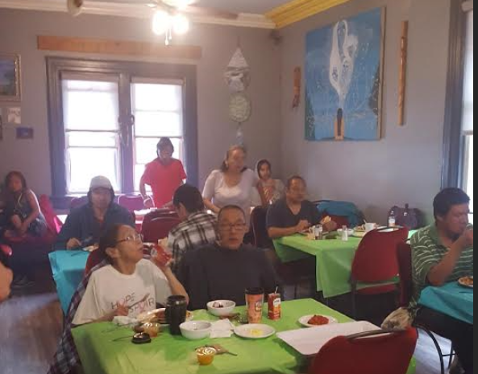
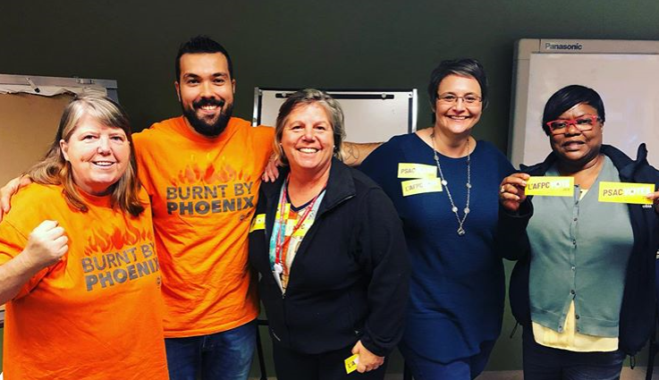
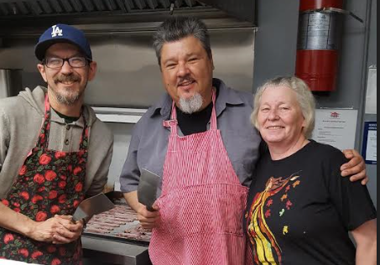
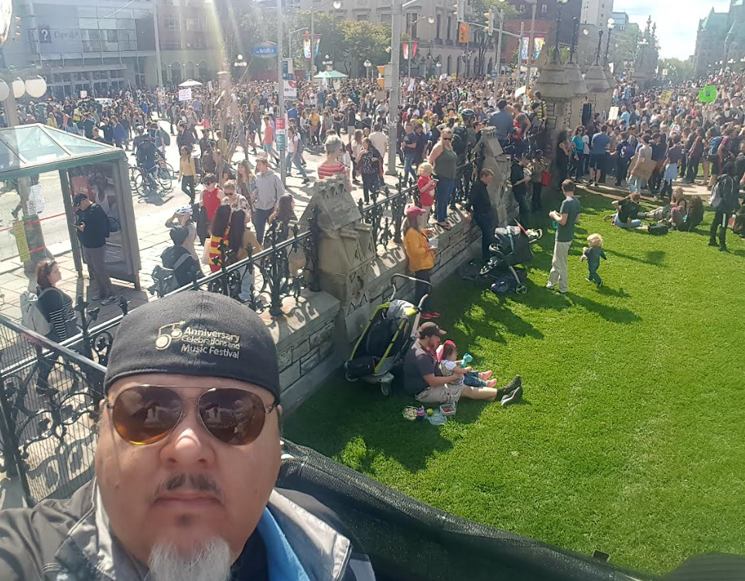
IAC Working in Community & partners
Hosting brunch at 510 Rideau homeless drop in shelter
Attending Climate Strike with other PSAC Members
Working with other Committees to organize the Human Rights night
IAC Working with local business Spaceman Music and community radio to raffle guitar
Sitting at information table at the NCR Union School
IAC member Carla door knocking during election in Orleans
Carla and other PSAC members door-knocking
Cooking for community drop in centre
Climate strike demonstration on Hill

Slide 5
Purpose
Affiliation: The IAC is the Regional Indigenous Peoples’ Circle representing the National Capital Region (NCR) of the National Indigenous Peoples’ Circle (NIPC) and is a recognized committee of the National Capital Regional Council (NCRC) of the Public Service Alliance of Canada (PSAC).
Mission: The IAC is committed to advancing and advocating on behalf of PSAC Indigenous members. The IAC will serve as an Indigenous Resource for PSAC Members and the PSAC Regional Office in the NCR
Objective: To provide the PSAC, PSAC National Capital Region Council (NCRC) and NCR Locals with advice and guidance on issues of importance to Indigenous members and the impact these issues have on Indigenous members.

Slide 6
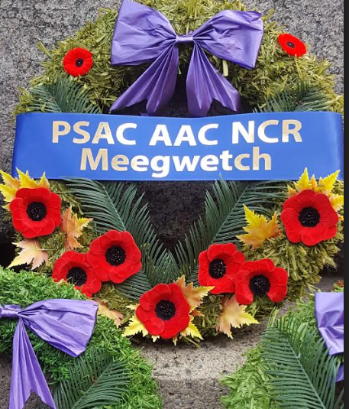
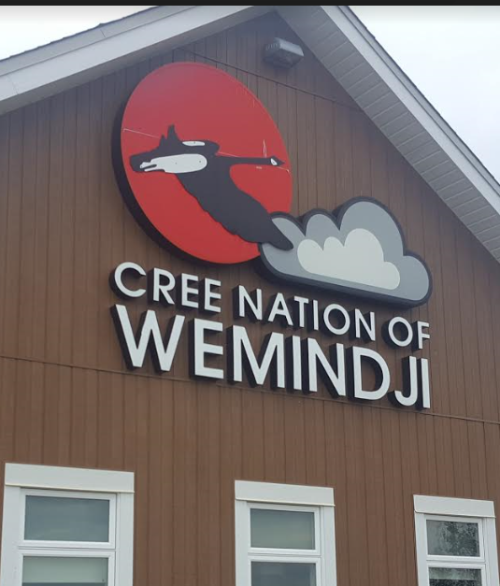
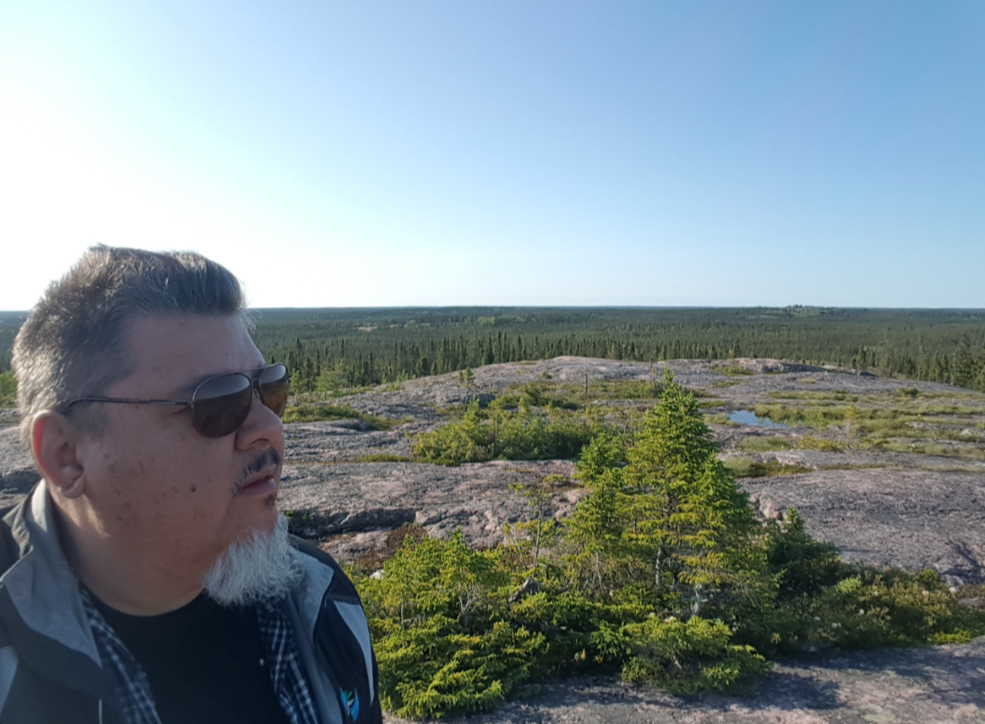
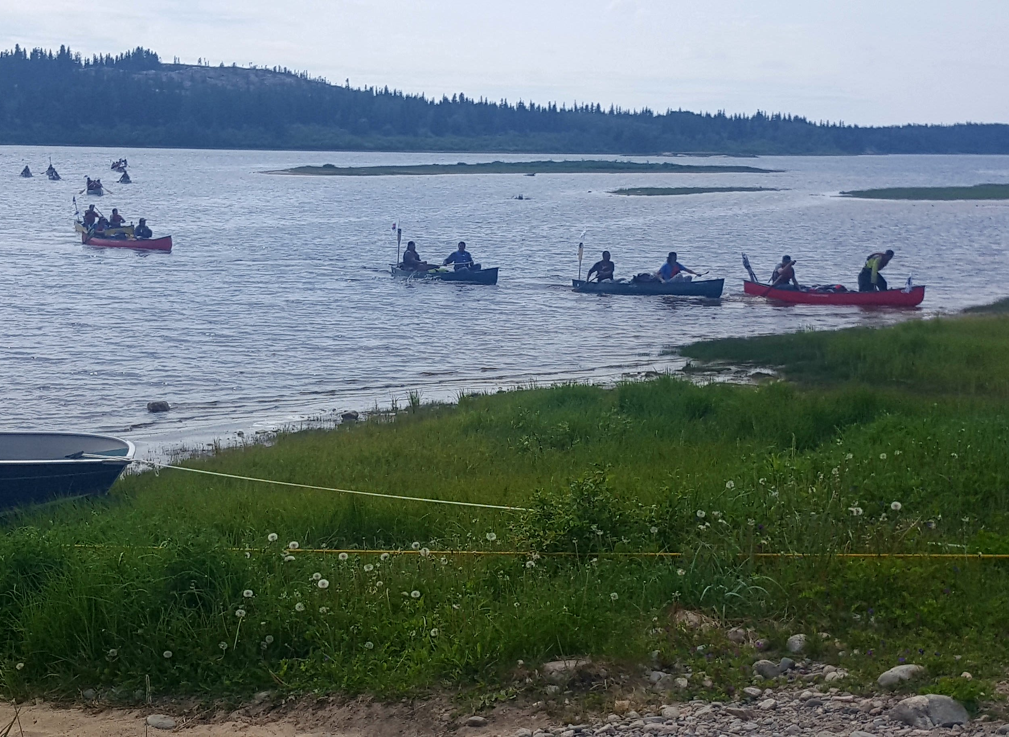
What’s next for 2020
Priorities for Coming Year
Insert input from Circle below:
Youth canoe expedition arrival Wemindji James Bay
Notes:
Consider talking about:
Provisions

Slide 7
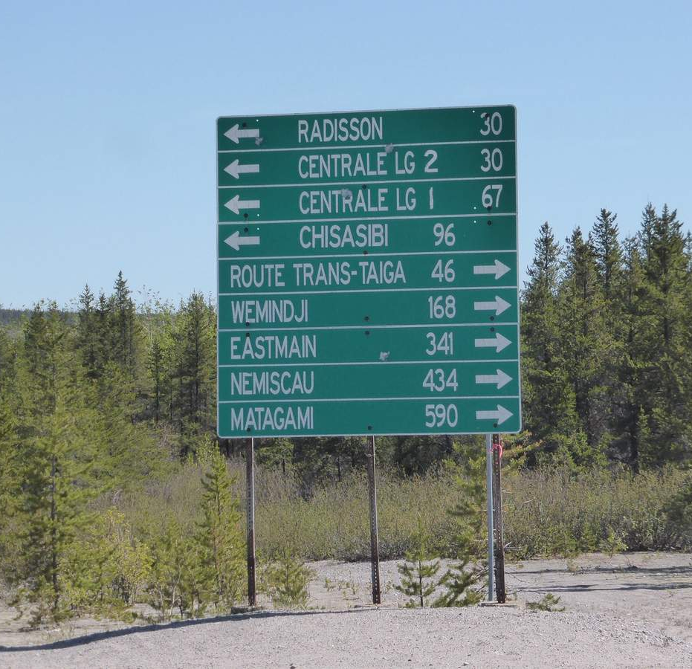
Plan for 2020 where do we go from here…..?
Community outreach/BBQ –Odawa?
Sponsor Children’s Pow Wow March
Partner with Indigenous CKCU live on site – Children’s Pow Wow
Two Spirited Pow Wow – TBD
Movie night-French – TBD
Easter Brunch 510 Rideau
December 510 Turkey brunch
A7G Youth Group
May and or June Indigenous Week
IEC Committees – outreach IAC membership drive – presentation – develop presentation
Pride Parade participation
June 20 Summer Solstice – Memorial
November 11, 8:45 (Wreath)
Skype participation

